Slide 1




SegFold: Accelerating Sparse GEMM with a Fine-Grained Dynamic Dataflow
Xinrui (Alice) Wu, Hanyu Wang, Jason Cong, Tony Nowatzki
alicewu24@g.ucla.edu

Slide 2
A Decade of Sparse Accelerators
Inner Product
Outer Product
Gustavson
Multi-dataflow
Single-sided / dense
Cnvlutin
ISCA 2016
SparTen
MICRO 2019
SpArch
HPCA 2020
Spada
ASPLOS 2023
EIE
ISCA 2016
SCNN
ISCA 2017
OuterSpace
HPCA 2018
ExTensor
MICRO 2019
SIGMA
HPCA 2020
Gamma
ASPLOS 2021
Flexagon
ASPLOS 2023
SPARM
ASAP 2024
Cambricon-X
MICRO 2016
TPU
ISCA 2017
SPU
MICRO 2019
MatRaptor
MICRO 2020
SPADE
ISCA 2023
Trapezoid
ISCA 2024
Tensaurus
HPCA 2020

Slide 3
One Dimension Remains Unexplored
Inner Product
Outer Product
Gustavson
Multi-dataflow
Single-sided / dense
Cnvlutin
ISCA 2016
SparTen
MICRO 2019
SpArch
HPCA 2020
Spada
ASPLOS 2023
dynamic - new axis
EIE
ISCA 2016
SCNN
ISCA 2017
OuterSpace
HPCA 2018
ExTensor
MICRO 2019
SIGMA
HPCA 2020
Gamma
ASPLOS 2021
Flexagon
ASPLOS 2023
SPARM
ASAP 2024
SegFold
ISCA 2026
dynamic dataflow
Cambricon-X
MICRO 2016
TPU
ISCA 2017
SPU
MICRO 2019
MatRaptor
MICRO 2020
SPADE
ISCA 2023
Trapezoid
ISCA 2024
Tensaurus
HPCA 2020
Dynamism

Slide 4
Static Dataflow
Fixed iteration order over the iteration space
Scientific Computing:
Finite element methods
Iterative solvers: Conjugate Gradient, GMRES, Algebraic multigrid
Graph Analytics:
Multi-hop traversal
Graph neural networks (GNNs)
Machine Learning:
Sparse attention
MoE routing
Structured sparsity in pruned DNNs

Slide 5
Static Dataflow
Fixed iteration order over the iteration space
B
B
B
A
C
A
C
A
C
Inner Product
Outer Product
Gustavson
Scientific Computing:
Finite element methods
Iterative solvers: Conjugate Gradient, GMRES, Algebraic multigrid
Graph Analytics:
Multi-hop traversal
Graph neural networks (GNNs)
Machine Learning:
Sparse attention
MoE routing
Structured sparsity in pruned DNNs

Slide 6
Static vs. Dynamic Dataflow on Spatial Architecture
B
B
A
C
A
C

Slide 7
Static vs. Dynamic Dataflow on Spatial Architecture
Static
B
B
A
C
A
C

Slide 8
Static vs. Dynamic Dataflow on Spatial Architecture
Static
Dynamic
B
B
A
C
A
C

Slide 9
Outline
01
Challenges in static dataflows
02
Opportunities for dynamic dataflow
03
SegFold Microarchitecture
04
Evaluation

Slide 10
Spatial Architecture: Distributed Computation
PE
PE
PE
PE
PE
PE
PE
PE
PE
PE
PE
PE
PE
PE
PE
PE

Slide 11
Spatial Architecture: Explicit Communication
Data Source
PE
PE
PE
PE
Data Sink
Goal 1: Increase Data Reuse
PE
PE
PE
PE
NoC
NoC
Goal 2: Balance Parallelized Computation
PE
PE
PE
PE
PE
PE
PE
PE

Slide 12
Static Execution has Irregularities
We use Gustavson as an example.
B
1
2
3
4
#: Dataflow execution order of A
5
6
A
C

Slide 13
Irregularity 1: Memory Access
B
1
2
3
4
#: Dataflow execution order of A
5
6
A
C

Slide 14
Irregularity 1: Memory Access
B row memory access depends on A sparse pattern and execution order
B
1
2
3
4
#: Dataflow execution order of A
5
6
A
C

Slide 15
Irregularities are Hard to Fit in Spatial Accelerator
Challenge : Redundant and bursty memory accesses
1
B
A
C

Slide 16
Irregularity 2: Computation/Communication
B
1
2
3
x
y
4
#: Dataflow execution order of A
5
6
A
C

Slide 17
Irregularity 2: Computation/Communication
B
1
2
3
x
y
z
4
#: Dataflow execution order of A
5
6
A
C

Slide 18
Irregularity 2: Computation/Communication
C nonzero pattern and reductions depend on A and B sparse pattern
B
1
2
3
x
y
z
4
#: Dataflow execution order of A
5
6
A
C

Slide 19
Irregularities are Hard to Fit in Spatial Accelerator
B
Challenge : Imbalanced number of computations and communications
2
A
C

Slide 20
SegFold: a dynamic dataflow
STATIC
=
Take in the data-dependent irregularities passively
DYNAMIC
=
Process the data-dependent irregularities on-the-fly

Slide 21
Spatial Scheduling

Slide 22
Spatial Scheduling on A’s Nonzero (bitmask)
1
To increase B reuse, we want to
maximize the number of A elements in a single column.
1
1
1
1
2
2
A
(a) Missed B Reuse
#: iterations

Slide 23
Spatial Scheduling on A’s Nonzero (bitmask)
1
To increase B reuse, we want to
maximize the number of A elements in a single column.
To increase C parallelized generation, we want to
minimize the number of A elements in a single row.
1
1
1
1
2
2
2
A
(b) Missed parallelism
#: iterations

Slide 24
Spatial Scheduling on A’s Nonzero (bitmask)
Each cycle
K
1
Scan A’s nonzeros along K (active window)
1
1
1
1
1
1
1
2
1
M
1
1
1
2
2
2
2
1
2
A
A
A
(a) Missed B Reuse
(b) Missed parallelism
(c) Ours
#: iterations

Slide 25
Spatial Scheduling on A’s Nonzero (bitmask)
Each cycle
K
1
Scan A’s nonzeros along K (active window)
1
1
1
1
1
1
1
2
1
Issue them in parallel across M
M
2
1
1
1
2
2
2
2
1
2
A
A
A
(a) Missed B Reuse
(b) Missed parallelism
(c) Ours
#: iterations

Slide 26
Spatial Scheduling on A’s Nonzero (bitmask)
Each cycle
K
1
Scan A’s nonzeros along K (active window)
1
1
1
1
1
1
1
2
1
Issue them in parallel across M
M
2
1
1
1
2
2
2
2
1
2
3
Load each B partial row, up to the idle budget (min)
A
A
A
(a) Missed B Reuse
(b) Missed parallelism
(c) Ours
#: iterations

Slide 27
Spatial Scheduling on A’s Nonzero (bitmask)
B
B
1
1
1
1
2
1
1
1
2
2
1
2
A
C
A
C

Slide 28
Spatial Scheduling on A’s Nonzero (bitmask)
Reduce the number of B row loads from three to two
B
B
1
1
1
1
2
1
1
1
2
2
1
2
A
C
A
C

Slide 29
Spatial Scheduling on A’s Nonzero (bitmask)
Reduce the number of B row loads from three to two
B
B
1
1
1
Increase the amount of parallelism from seven to eight
1
2
2
A
C
C

Slide 30
Temporal Redistribution: Maintains Sparse C On-the-fly
column indices
column indices
0
1
2
3
0
1
2
3
2
Generated psums
Nonzero outputs
1st iteration
2nd iteration

Slide 31
Temporal Redistribution: Maintains Sparse C On-the-fly
column indices
column indices
0
1
2
3
0
1
2
3

Slide 32
Temporal Redistribution: Maintains Sparse C On-the-fly
column indices
column indices
0
1
2
3
0
1
2
3

Slide 33
Temporal Redistribution: Maintains Sparse C On-the-fly
column indices
column indices
0
1
2
3
0
1
2
3
1
3
1
3
0
2
0
2

Slide 34
Temporal Redistribution: Maintains Sparse C On-the-fly
column indices
column indices
0
1
2
3
0
1
2
3
1
3
1
3
1
3
1
3
0
2
0
2
0
2
0
2

Slide 35
Temporal Redistribution: Maintains Sparse C On-the-fly
column indices
column indices
0
1
2
3
0
1
2
3
1
3
1
3
1
3
0
1
3
New intersections
update the distribution
0
2
0
2
0
2
0
1
2

Slide 36
SegFold: a new microarchitecture
A specialized memory controller and hierarchical network support the dynamic dataflow.

Slide 37
SegFold Microarchitecture: Computation
PE
PE
PE
PE
PE
PE
PE
PE
PE
PE
PE
PE

Slide 38
SegFold Microarchitecture: Computation
PE
PE
PE
>>
PE
PE
PE
>>
PE
PE
PE
>>
PE
PE
PE
>>

Slide 39
SegFold Microarchitecture: Memory
DRAM
PE
PE
PE
Data Cache
>>
PE
PE
PE
>>
PE
PE
PE
>>
PE
PE
PE
>>

Slide 40
SegFold Microarchitecture: Memory
DRAM
PE
PE
PE
Data Cache
>>
Memory Controller
PE
PE
PE
Mapping Lookup Table
>>
PE
PE
PE
>>
PE
PE
PE
>>

Slide 41
SegFold Microarchitecture: Memory
DRAM
PE
PE
PE
Data Cache
>>
Memory Controller
PE
PE
PE
Mapping Lookup Table
>>
tail ptr
head ptr
row idx
PE
PE
PE
0
1
0
0
0
1
Active window
Active window
0
1
1
>>
1
0
0
1
1
0
PE
PE
PE
0
1
1
A’s bitmask
B’s metadata
>>
Metadata Scratchpad

Slide 42
Datapath in SegFold Microarchitecture
DRAM
PE
PE
PE
Data Cache
>>
Memory Controller
PE
PE
PE
Mapping Lookup Table
>>
tail ptr
head ptr
row idx
PE
PE
PE
0
1
0
0
0
1
Active window
Active window
0
1
1
>>
1
0
0
1
1
0
PE
PE
PE
0
1
1
A’s bitmask
B’s metadata
>>
Metadata Scratchpad

Slide 43
SelectA on Metadata
DRAM
PE
PE
PE
Data Cache
>>
Memory Controller
PE
PE
PE
Mapping Lookup Table
>>
tail ptr
head ptr
row idx
PE
PE
PE
0
1
0
0
0
1
Active window
Active window
0
1
1
>>
1
0
0
1
1
0
PE
PE
PE
0
1
1
A’s bitmask
B’s metadata
>>
Metadata Scratchpad

Slide 44
Distribute A Element
DRAM
PE
PE
PE
Data Cache
>>
Memory Controller
PE
PE
PE
Mapping Lookup Table
>>
tail ptr
head ptr
row idx
PE
PE
PE
0
1
0
0
0
1
Active window
Active window
0
1
1
>>
1
0
0
1
1
0
PE
PE
PE
0
1
1
A’s bitmask
B’s metadata
>>
Metadata Scratchpad

Slide 45
Distribute A Element with Broadcasting
DRAM
PE
PE
PE
Data Cache
>>
Memory Controller
PE
PE
PE
Mapping Lookup Table
>>
tail ptr
head ptr
row idx
PE
PE
PE
0
1
0
0
0
1
Active window
Active window
0
1
1
>>
1
0
0
1
1
0
PE
PE
PE
0
1
1
A’s bitmask
B’s metadata
>>
Metadata Scratchpad

Slide 46
Distribute A Elements with Multi-Broadcasting
DRAM
PE
PE
PE
Data Cache
Broadcast A
>>
Memory Controller
PE
PE
PE
Mapping Lookup Table
>>
tail ptr
head ptr
row idx
PE
PE
PE
0
1
0
0
0
1
Active window
Active window
0
1
1
>>
1
0
0
1
1
0
PE
PE
PE
0
1
1
A’s bitmask
B’s metadata
>>
Metadata Scratchpad

Slide 47
Distribute B Vector
DRAM
PE
PE
PE
Data Cache
Broadcast A
>>
Memory Controller
PE
PE
PE
Mapping Lookup Table
>>
tail ptr
head ptr
row idx
PE
PE
PE
0
1
0
0
0
1
Active window
Active window
0
1
1
>>
1
0
0
1
1
0
PE
PE
PE
0
1
1
A’s bitmask
B’s metadata
>>
Metadata Scratchpad

Slide 48
Distribute B Vector with Shifter
DRAM
PE
PE
PE
Data Cache
Broadcast A
>>
Memory Controller
PE
PE
PE
Mapping Lookup Table
>>
tail ptr
head ptr
row idx
PE
PE
PE
0
1
0
0
0
1
Active window
Active window
0
1
1
>>
1
0
0
1
1
0
PE
PE
PE
0
1
1
A’s bitmask
B’s metadata
>>
Metadata Scratchpad

Slide 49
Distribute B Vector with Vector-Multicast Network
DRAM
PE
PE
PE
Data Cache
Broadcast A
>>
Memory Controller
Vector Multicast B
PE
PE
PE
Mapping Lookup Table
>>
tail ptr
head ptr
row idx
PE
PE
PE
0
1
0
0
0
1
Active window
Active window
0
1
1
>>
1
0
0
1
1
0
PE
PE
PE
0
1
1
A’s bitmask
B’s metadata
>>
Metadata Scratchpad

Slide 50
SegmentBC on PE Row
DRAM
PE
PE
PE
Data Cache
Broadcast A
>>
Memory Controller
Vector Multicast B
PE
PE
PE
Mapping Lookup Table
>>
tail ptr
head ptr
row idx
PE
PE
PE
0
1
0
0
0
1
Active window
Active window
0
1
1
>>
1
0
0
1
1
0
PE
PE
PE
0
1
1
A’s bitmask
B’s metadata
>>
Metadata Scratchpad

Slide 51
SegmentBC on PE Row
DRAM
PE
PE
PE
Data Cache
Broadcast A
>>
Memory Controller
Vector Multicast B
PE
PE
PE
Mapping Lookup Table
>>
tail ptr
head ptr
row idx
PE
PE
PE
0
1
0
0
0
1
Active window
Active window
0
1
1
>>
1
0
0
1
1
0
PE
PE
PE
0
1
1
A’s bitmask
B’s metadata
>>
Metadata Scratchpad

Slide 52
SegmentBC on PE Row
DRAM
PE
PE
PE
Data Cache
Broadcast A
>>
Memory Controller
Vector Multicast B
PE
PE
PE
PE
Mapping Lookup Table
>>
tail ptr
head ptr
row idx
PE
PE
PE
0
1
0
0
0
1
Active window
Active window
0
1
1
>>
1
0
0
1
1
0
PE
PE
PE
0
1
1
A’s bitmask
B’s metadata
>>
Metadata Scratchpad

Slide 53
Folding Mechanism for Better Utilization
DRAM
PE
PE
PE
Data Cache
Broadcast A
>>
Memory Controller
Vector Multicast B
PE
PE
PE
PE
Mapping Lookup Table
>>
tail ptr
head ptr
row idx
PE
PE
PE
0
1
0
0
0
1
Active window
Active window
0
1
1
>>
1
0
0
1
1
0
PE
PE
PE
0
1
1
A’s bitmask
B’s metadata
>>
Metadata Scratchpad

Slide 54
Evaluation

Slide 55
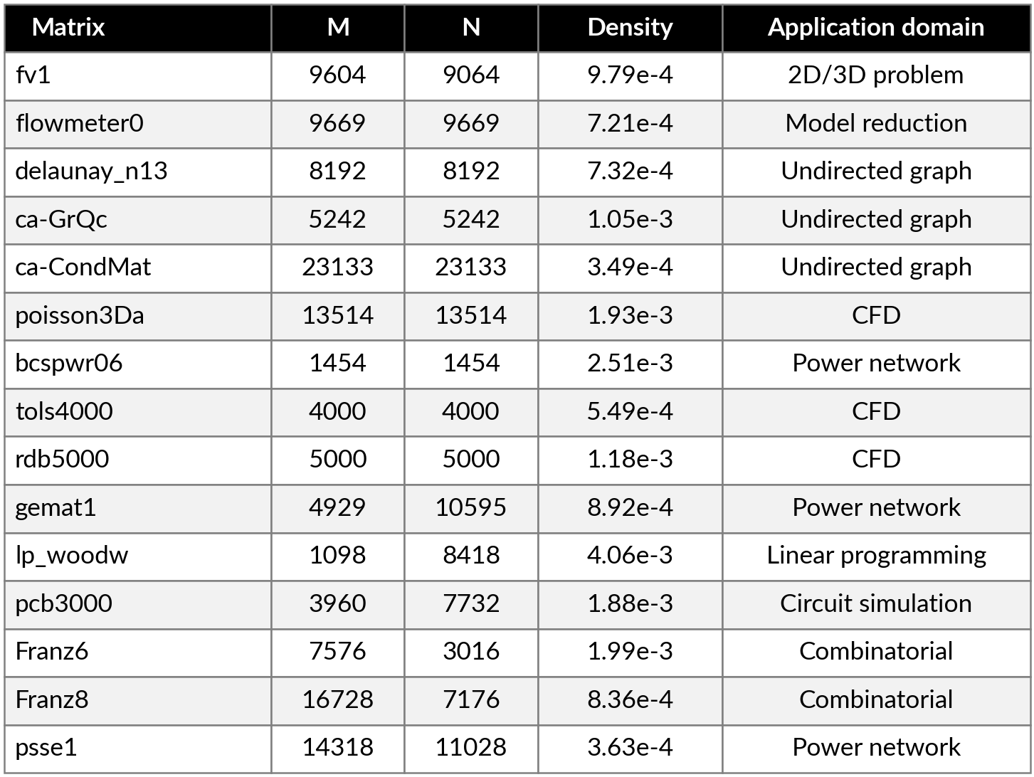
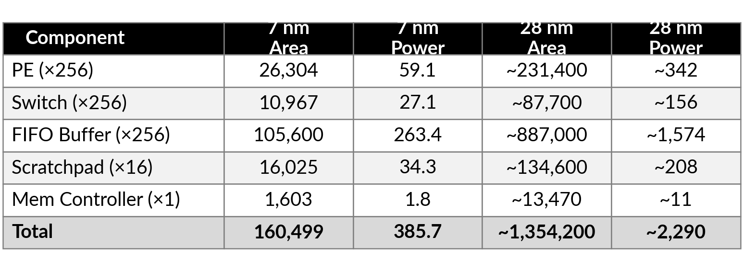
Methodology
TABLE I: SuiteSparse matrices used in evaluation
Benchmarks:
SuiteSparse matrices
Synthetic matrices (ablation)
Simulations:
Cycle-level simulator
Ramulator2 memory backend
Baselines:
Flexagon (three static dataflows)
Spada (one sub-tile static dataflow)
TABLE II: Area (µm²) & power (mW); 7 nm synth., 28 nm est.
Total die area: 0.160 mm² (7 nm), ~1.35 mm² (28 nm)

Slide 56
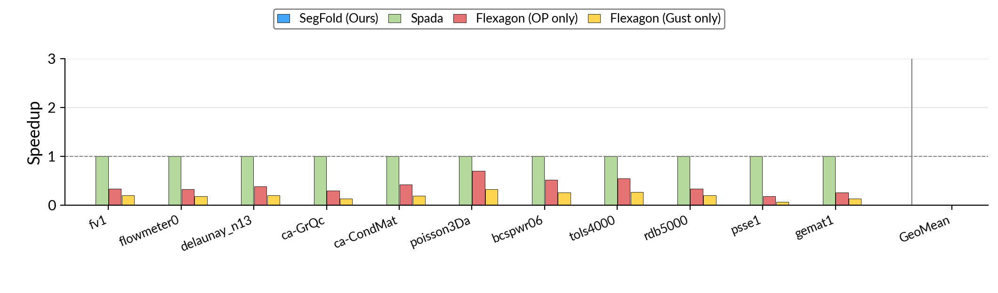
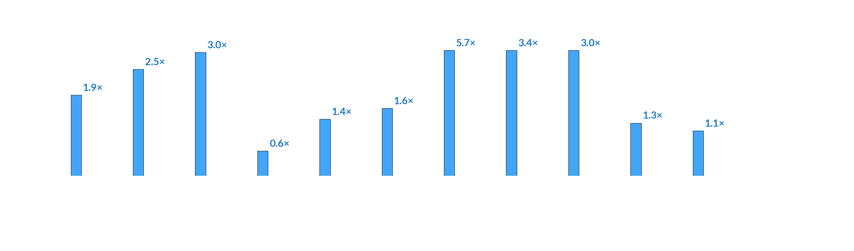
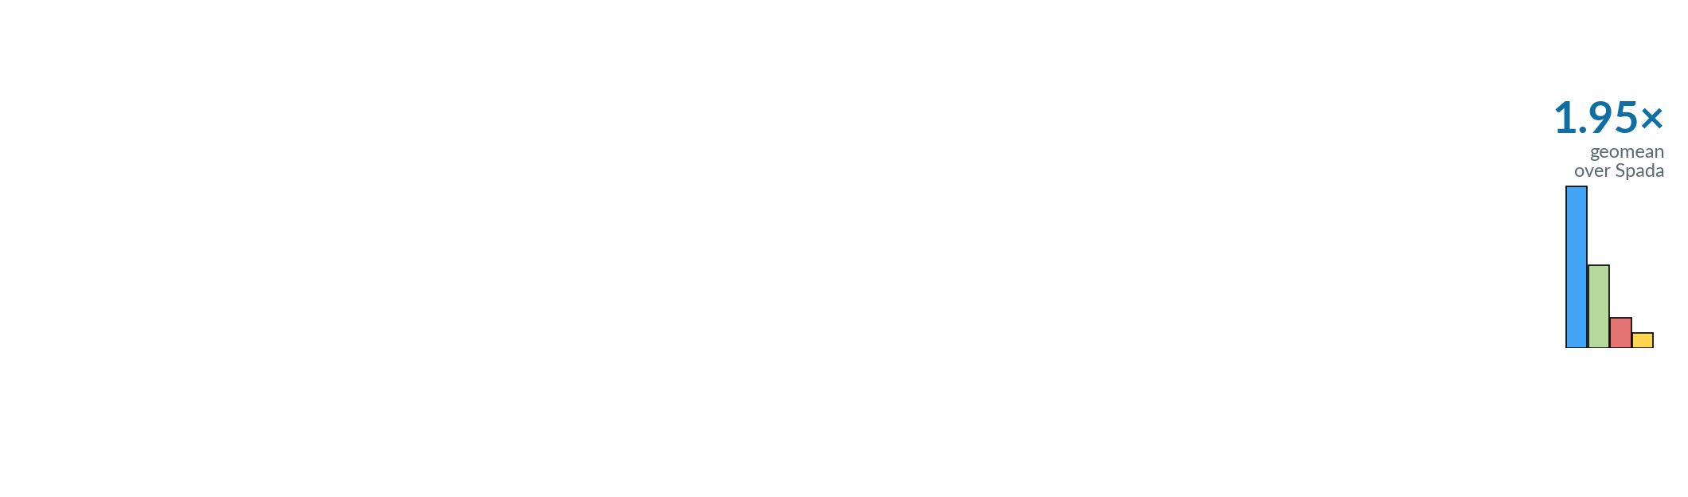
Overall Performance

Slide 57
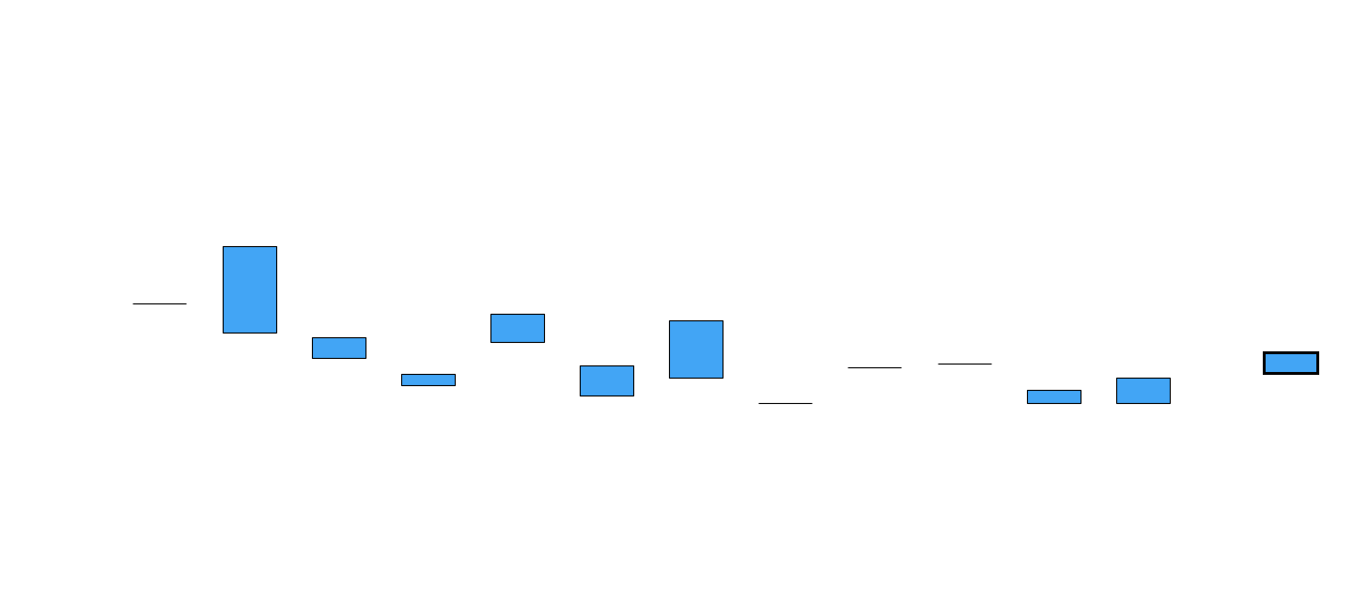
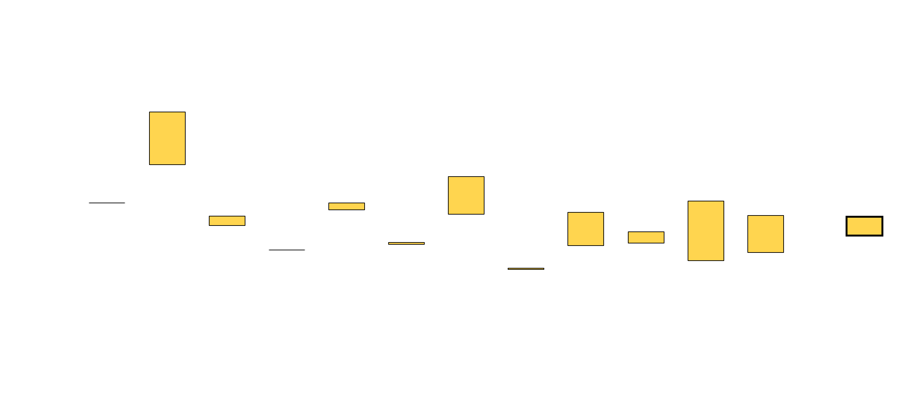
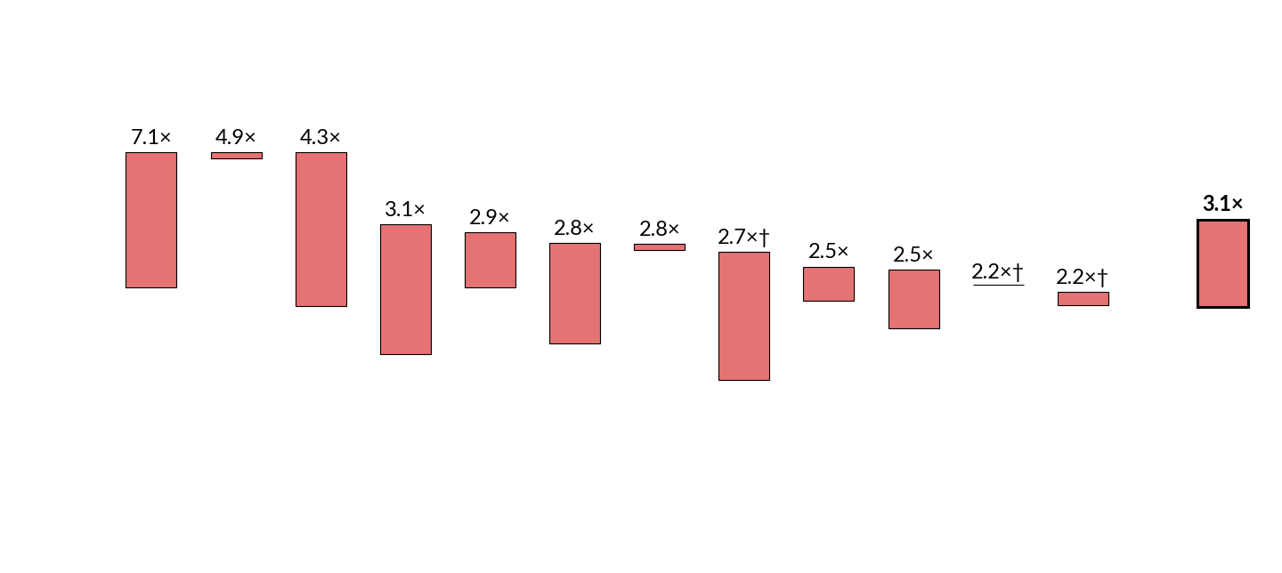
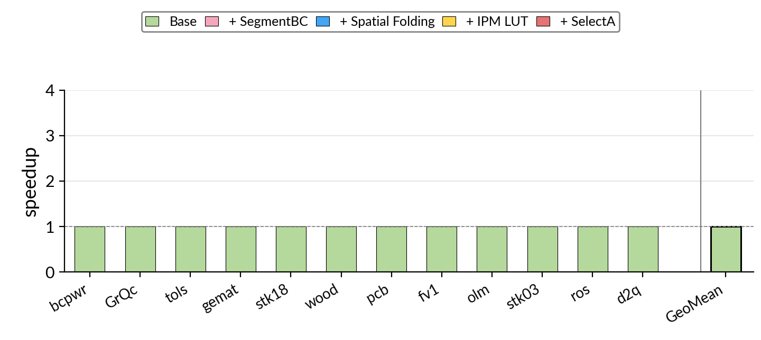
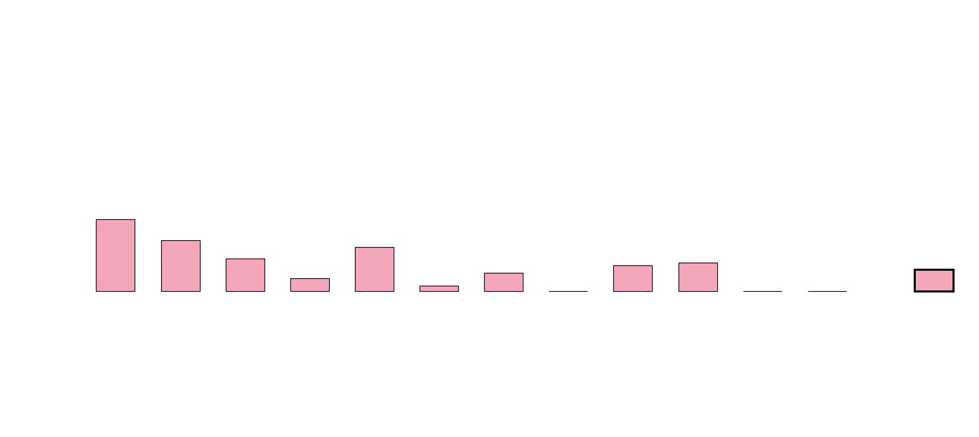
Ablation

Slide 58
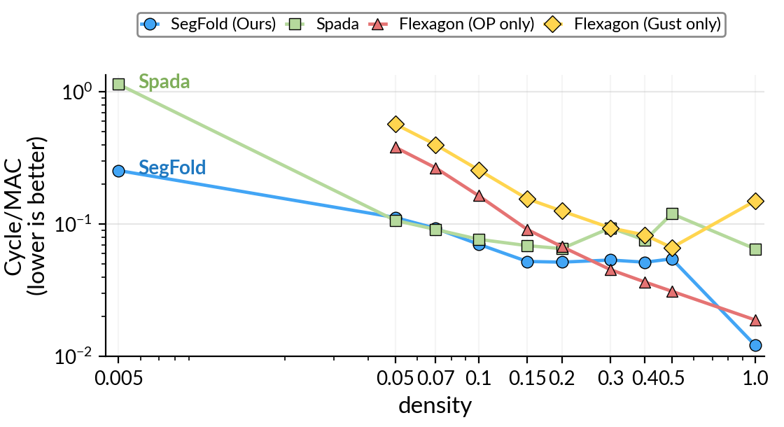
Sensitivity Studies

Slide 59
Conclusion
Dynamism is essential for data-dependent sparsity in SpGEMM.
1.95×
Dynamic scheduling improves data reuse and parallelism.
geomean speedup over SOTA accelerators
Dynamic redistribution & mapping absorb sparsity-induced irregularity at runtime.
5.3× over the best static dataflow

